Slide 1
Content Delivery
Presented by—
G. Nandini (161FA04289)
M. Sukanya (161FA04312)

Slide 2
Topics covered:
Introduction
Content & Internet Traffic
Server Farms & Web Proxies
Content Delivery Networks
Peer–to–Peer Networks

Slide 3
Introduction:
The Internet used to be all about communication.
Since the Web grew up, However, the Internet has become more about content than communication.
Many people use the Web to find information, and there is a tremendous amount of peer-to-peer file sharing that is driven by access to movies, music, and programs.
The other difference is that some Web sites that provide content have become tremendously popular.

Slide 4
contd…
Two Architectures have been developed to use bandwidth for
distributing content :
Content Distribution Network:
In it, a provider sets up a distributed collection of machines at locations inside the Internet and uses them to serve content to clients.
Peer-to-Peer Network:
In it, a collection of computers pool their resources to serve content to each other, without separately provisioned servers or any central point of control.

Slide 5
Content & Internet Traffic:
To design and engineer networks that work well, we need an understanding of the traffic that they must carry.
There are only two facts about Internet traffic.
The first fact is that it changes quickly, not only in the details but in the overall makeup.
Before 1994, most traffic was traditional FTP file transfer and email. Then the Web arrived and grew exponentially.
Web traffic left FTP and email traffic and Starting around 2000, P2P file sharing .
Sometime in the late 2000s, video streamed using content distribution methods by sites like YouTube began to exceed P2P traffic by 2014.

Slide 6
Contd….
Second fact is that it is highly skewed.
Many properties with which we are familiar are clustered around an average.
Internet traffic is not like this. For a long time, it has been known that there are a small number of Web sites with massive traffic and a vast number of Web site with much smaller traffic.

Slide 7
Server farms & Web proxies:
To build large Web sites that perform well, we can speed up processing on either the server side or the client side.
On the server side, more powerful Web servers can be built with a server farm, in which a cluster of computers acts as a single server.
On the client side, better performance can be achieved with better caching techniques.
In particular, proxy caches provide a large shared cache for a group of clients.

Slide 8
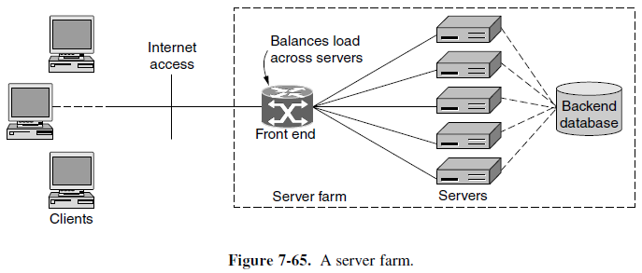
Server Farms:

Slide 9
Contd..
There are several possible solutions to make the set of servers appear to be one Web site. All of the solutions assume that any of the servers can handle a request from any client. To do this, each server must have a copy of the Web site.
One solution is to use DNS to spread the requests across the servers in the server farm. When a DNS request is made for the Web URL, the DNS server returns a rotating list of the IP addresses of the servers.
Each client tries one IP address, typically the first on the list. The effect is that different clients contact different servers to access the same Web site, just as intended.
The other solutions are based on a front end that sprays incoming requests over the pool of servers in the server farm.

Slide 10
Contd…
This happens even when the client contacts the server farm using a single destination IP address. The front end is usually a link-layer switch or an IP router, that is, a device that handles frames or packets.
A Web request and response are carried as a TCP connection. To work correctly, the front end must distribute all of the packets for a request to the same server.
A simple design is for the front end to broadcast all of the incoming requests to all of the servers. Each server answers only a fraction of the requests by prior agreement.
For example, 16 servers might look at the source IP address and reply to the request only if the last 4 bits of the source IP address match their configured selectors.
Other packets are discarded. While this is wasteful of incoming bandwidth, often the responses are much longer than the request.

Slide 11
Contd…
In a more general design, the front end may inspect the IP, TCP, and HTTP headers of packets and arbitrarily map them to a server.
The mapping is called a load balancing policy as the goal is to balance the workload across the servers.
A simple policy might be to use the servers one after the other in turn, or round-robin.
With this approach, the front end must remember the mapping for each request so that subsequent packets that are part of the same request will be sent to the same server.
Also the front end should notice when servers have failed and stop sending them requests.

Slide 12
Contd…
The reason for looking at the HTTP headers is somewhat different. Many Web interactions access and update databases, such as when a customer looks up her most recent purchase.
The server that fields this request will have to query the back-end database. It is useful to direct subsequent requests from the same user to the same server, because that server has already cached information about the user.

Slide 13
Web Proxies :
Web requests and responses are sent using HTTP. we described how browsers can cache responses and reuse them to answer future requests .
Various header fields and rules are used by the browser to determine if a cached copy of a Web page is still fresh.
Caching improves performance by shortening the response time and reducing the network load.
If the browser can determine that a cached page is fresh by itself , the page can be fetched from the cache immediately, with no network traffic at all.
However, even if the browser must ask the server for confirmation that the page is still fresh.

Slide 14
Contd…
One strategy to make caches more effective is to share the cache among multiple users. That way, a page already fetched for one user can be returned to another user when that user makes the same request.
A Web proxy is used to share a cache among users. A proxy is an agent that acts on behalf of someone else, such as the user. There are many kinds of proxies.
A Web proxy fetches Web requests on behalf of its users. It normally provides caching of the Web responses, and since it is shared across users it has a substantially larger cache than a browser.
When a proxy is used, the typical setup is for an organization to operate one Web proxy for all of its users.

Slide 15
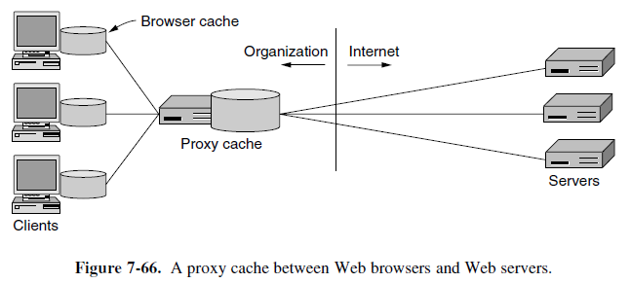
Contd…

Slide 16
Contd…
The proxy is only consulted after the browser has tried to satisfy the request from its own cache. That is, the proxy provides a second level of caching.
Further proxies may be added to provide additional levels of caching. Each proxy (or browser) makes requests via its upstream proxy. Each upstream proxy caches for the downstream proxies (or browsers).
Web proxies provide additional benefits :
One benefit is to filter content.
Another benefit of having proxies is privacy or anonymity, when the proxy shields the identity of the user from the server.

Slide 17
Content Delivery Networks :
CDNs (Content Delivery Networks) turn the idea of traditional Web caching on its head.
Instead, of having clients look for a copy of the requested page in a nearby cache, it is the provider who places a copy of the page in a set of nodes at different locations and directs the client to use a nearby node as the server.

Slide 18
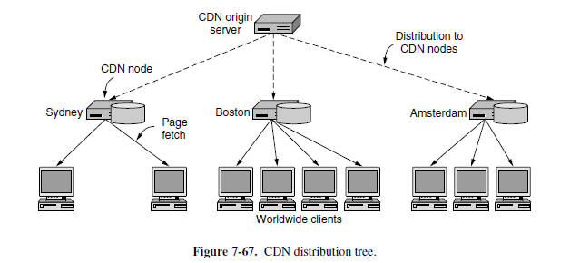
Contd..

Slide 19
Contd…
Using a tree structure has three virtues.
First, the content distribution can be scaled up to as many clients as needed by using more nodes in the CDN, and more levels in the tree.
Second, each client gets good performance by fetching pages from a nearby server instead of a distant server.
Finally, the total load that is placed on the network is also kept at a minimum. If the CDN nodes are well placed, the traffic for a given page should pass over each part of the network only once.

Slide 20
Contd…
Another simple way to support a distribution tree with one level is to use mirroring.
In this approach, the origin server replicates content over the CDN nodes as before. The CDN nodes in different network regions are called mirrors.
The Web pages on the origin server contain explicit links to the different mirrors, usually telling the user their location.
This design lets the user manually select a nearby mirror to use for downloading content.
A typical use of mirroring is to place a large software package on mirrors located in, for example, the East and West coasts of the U.S., Asia, and Europe.
Mirrored sites are generally completely static, and the choice of sites remains stable for months or years.

Slide 21
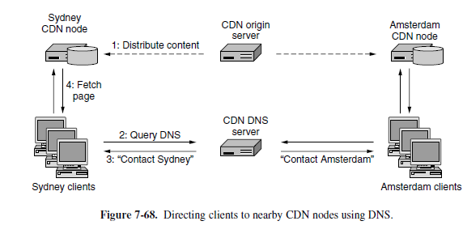
Contd…

Slide 22
Contd…
To define nearest, it is not really geography that matters. There are at least two factors to consider in mapping a client to a CDN node.
One factor is the network distance. The client should have a short and high-capacity network path to the CDN node.
The second factor is the load that is already being carried by the CDN node. If the CDN nodes are overloaded, they will deliver slow responses.

Slide 23
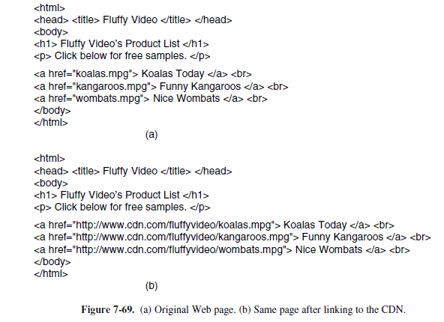
Contd…

Slide 24
Peer-to-peer Networks :
The basic idea of a P2P (Peer-to-Peer) file-sharing network is that many computers come together and pool their resources to form a content distribution system. The computers are often simply home computers.
The computers are called peers because each one can alternately act as a client to another peer, fetching its content, and as a server, providing content to other peers.
The thing makes peer-to-peer systems interesting is that there is no dedicated infrastructure, like in a CDN. Everyone participates in the task of distributing content, and there is often no central point of control.

Slide 25
Contd…
P2P technology has followed two related paths as it has been developed. On the more practical side, there are the systems that are used every day.
The most well known of these systems are based on the Bit Torrent protocol.
On the more academic side, there has been intense interest in DHT (Distributed Hash Table) algorithms that let P2P systems perform well as a whole, yet rely on no centralized components at all.

Slide 26
Bit torrent :
In a typical peer-to-peer system, like that formed with Bit Torrent, the users each have some information that may be of interest to other users.
There are three problems that need to be solved to share content :
1. How does a peer find other peers that have the content it wants to download?
2. How is content replicated by peers to provide high-speed downloads for everyone?
3. How do peers encourage each other to upload content to others as well as download content for themselves?
The first problem exists because not all peers will have all of the content, at least initially. The approach taken in Bit Torrent is for every content provider to create a content description called a torrent.

Slide 27
Bit torrent :
The torrent is much smaller than the content, and is used by a peer to verify the integrity of the data that it downloads from other peers. Other users who want to download the content must first obtain the torrent, say, by finding it on a Web page advertising the content.
The torrent contains two key kinds of information. One kind is the name of a tracker, which is a server that leads peers to the content of the torrent. The other kind of information is a list of equal-sized pieces, or chunks, that make up the content.
To download the content described in a torrent, a peer first contacts the tracker for the torrent. The tracker is a server that maintains a list of all the other peers that are actively downloading and uploading the content. This set of peers is called a swarm.
The members of the swarm contact the tracker regularly to report that they are still active, as well as when they leave the swarm. When a new peer contacts the tracker to join the swarm, the tracker tells it about other peers in the swarm.

Slide 28
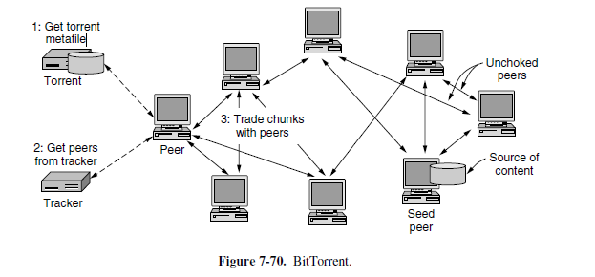
Contd… Getting the torrent and contacting the tracker are the first two steps for downloading content.

Slide 29
Contd..
When a swarm is first formed, some peers must have all of the chunks that make up the content. These peers are called seeders. Other peers that join the swarm will have no chunks; they are the peers that are downloading the content.
While a peer participates in a swarm, it simultaneously downloads chunks that it is missing from other peers, and uploads chunks that it has to other peers who need them.
The peer can leave the swarm (and return) at any time. Normally a peer will stay for a short period after finishes its own download. With peers coming and going, the rate of churn in a swarm can be quite high.
peers exchange lists of the chunks they have with each other.
Then they select rare chunks that are hard to find to download. The idea is that downloading a rare chunk will make a copy of it, which will make the chunk easier for other peers to find and download. If all peers do this, after a short while all chunks will be widely available.

Slide 30
Contd..
P2P nodes are users’ computers, and the users may be more interested in getting a movie than helping other users with their downloads.
Nodes that take resources from a system without contributing in kind are called free-riders or lechers.
The approach taken in Bit Torrent clients is to reward peers who show good upload behaviour.
The peer continues to trade chunks with only a small number of peers that provide the highest download performance, while also randomly trying other peers to find good partners.
The peers with which a node is currently exchanging chunks are said to be unchoked.
The more a peer is contributing to the other peers, the more it can expect in return.

Slide 31
Distributed Hash tables:
The traditional form of Bit Torrent uses peer-to-peer transfers and a centralized tracker for each swarm. It is the tracker that turns out to be the hard part to decentralize in a peer-to-peer system. The key problem is how to find out which peers have specific content that is being sought.
Having every peer keep its own index does not help. But keeping the indexes distributed helps all peers. However, it requires so much work to keep the indexes of all peers up to date (as content is moved about the system) that it is not worth the effort.

Slide 32
Contd…
To have better performance of keeping indexes of all peers, we mean three things.
First, each node keeps only a small amount of information about other nodes. This property means that it will not be expensive to keep the index up to date.
Second, each node can look up entries in the index quickly. Otherwise, it is not a very useful index.
Third, each node can use the index at the same time, even as other nodes come and go. This property means the performance of the index grows with the number of nodes.
This is known as DHTs (Distributed Hash Tables) because the basic functionality of an index is to map a key to a value. This is like a hash table, and the solutions are distributed.

Slide 33
Contd…
DHTs do their work by imposing a regular structure on the communication between the nodes. So, DHTs are called structured P2P networks. Traditional P2P protocols build unstructured P2P networks.
A Chord DHT consists of n participating nodes. Each node has an IP address by which it may be contacted.
The key part of Chord is that it navigates the index using identifiers in a virtual space, not the IP addresses of nodes or the names of content like movies.
Conceptually, the identifiers are simply m-bit numbers that can be arranged in ascending order into a ring.

Slide 34
Contd…
To turn a node address into an identifier, it is mapped to an m-bit number using a hash function, hash. Chord uses SHA-1 for hash, it is just a function that takes a variable-length byte string as an argument and produces a highly random 160-bit number. Thus, we can use it to convert any IP address to a 160-bit number called the node identifier.
In this example, the nodes with identifiers 1, 4, 7, 12, 15, 20, and 27 correspond to actual nodes.
Let us now define the function successor(k) as the node identifier of the first actual node following k around the circle, clockwise. For example, successor (6) = 7, successor (8) = 12, and successor (22) = 27.

Slide 35
Contd…
To start a new a swarm, a node needs to insert a new key-value pair consisting of (torrent, my-IP-address) into the index.
To accomplish this, the node asks successor(hash(torrent )) to store my-IP-address. In this way, the index is distributed over the nodes at random. For fault tolerance, p different hash functions could be used to store the data at p nodes.
Some time after the DHT is constructed, another node wants to find a torrent so that it can join the swarm and download content.
A node looks up torrent by first hashing it to get key, and second using successor (key) to find the IP address of the node storing the corresponding value. The value is the list of peers in the swarm; the node can add its IP address to the list and contact the other peers to download content with the Bit Torrent protocol.

Slide 36
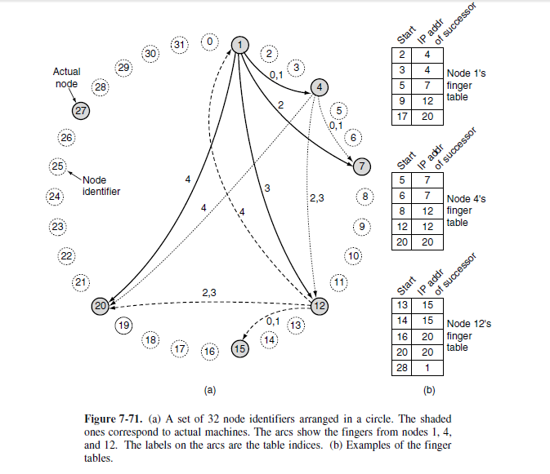
Contd…

Slide 37
Contd…
To find the IP address of the node corresponding to a certain key, each node is required to maintain certain administrative data structures.
One of these is the IP address of its successor node along the node identifier circle.
Lookup can now proceed as follows.
The requesting node sends a packet to its successor containing its IP address and the key it is looking for.
The packet is propagated around the ring until it locates the successor to the node identifier being sought.
That node checks to see if it has any information matching the key, and if so, returns it directly to the requesting node, whose IP address it has.

Slide 38
Contd…
linearly searching all the nodes is very inefficient in a large peer to- peer system since the mean number of nodes required per search is n/2.
To greatly speed up the search, each node also maintains what Chord calls a finger table.
The finger table has m entries, indexed by 0 through m − 1, each one pointing to a different actual node. Each of the entries has two fields: start and the IP address of successor, as shown above
The values of the fields for entry i at a node with identifier k are:
start = k + 2i (modulo 2m)
IP address of successor(start [i ])

Slide 39
Contd…
Using the finger table, the lookup of key at node k proceeds as follows.
If key falls between k and successor (k), the node holding information about key is successor (k) and the search terminates.
Otherwise, the finger table is searched to find the entry whose start field is the closest predecessor of key. A request is then sent directly to the IP address in that finger table entry to ask it to continue the search.
Since it is closer to key but still below it, chances are good that it will be able to return the answer with only a small number of additional queries. In fact, since every lookup halves the remaining distance to the target, it can be shown that the average number of lookups is log2n.

Slide 40
Contd…
When a node leaves gracefully, it hands its keys over to its successor and informs its predecessor of its departure so the predecessor can link to the departing node’s successor.
When a node crashes, a problem arises because its predecessor no longer has a valid successor. To alleviate this problem,
Each node keeps track not only of its direct successor but also its ‘s’ direct successors, to allow it to skip over up to s − 1 consecutive failed nodes and reconnect the circle if disaster strikes.

Slide 41


